Slide 1
PDC Technologies
SW 404 – Networking Concepts Final Project
Professor – Dr. Sette
Roja Dhanavath,
12-14-16

Slide 2
Agenda
Introduction
Project Assignments
Network Diagrams
Network Address Routing Table
Validation and Verification
Conclusion

Slide 3
Introduction
Client wished to expand a preexisting network
Their setup consisted of a PC at the main desk, A PC for the Manager, and the PC in the Boss’ office
We were tasked with adding wireless functionality to the office network
Cisco Packet Tracer 7.0
Servers: Web, DNS+DHCP
Protocols: RIP
Wiring: Cat6
Serial Connection between Routers

Slide 4
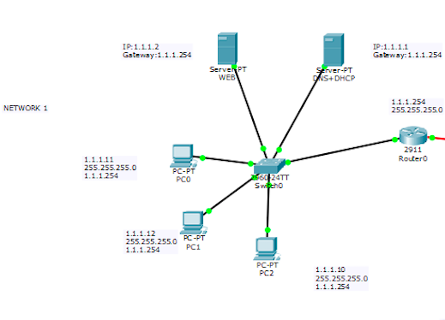
Network Diagrams

Slide 5
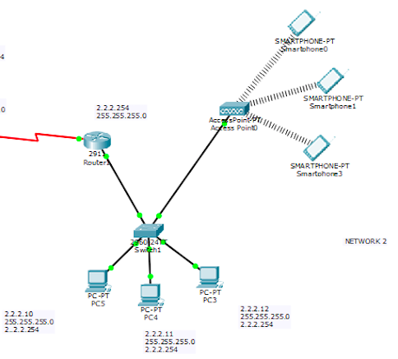
Network Diagrams

Slide 6
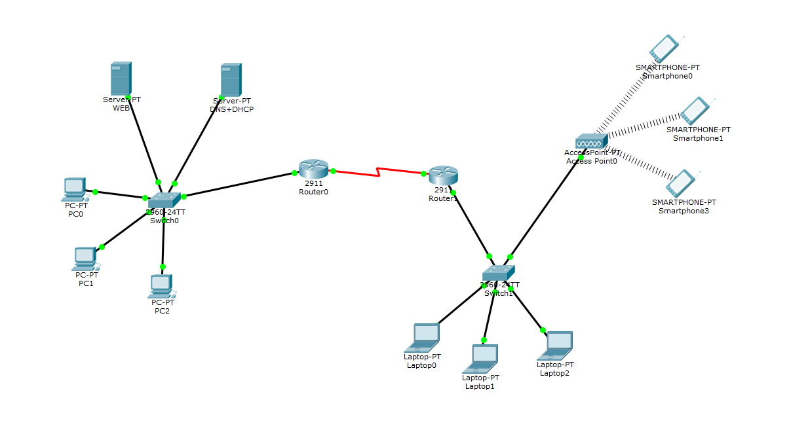
Network Diagrams

Slide 7
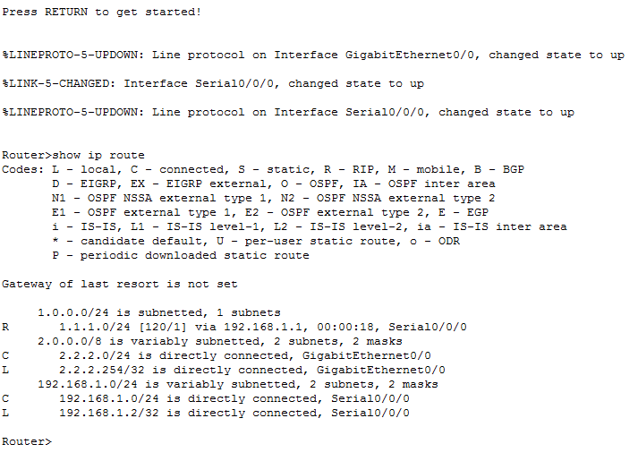
Network Diagrams

Slide 8
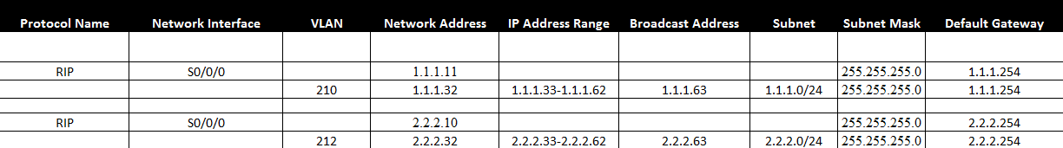
Network Address Routing Tables

Slide 9
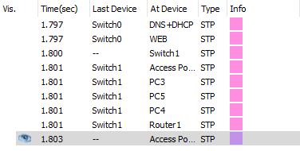
Validation and Verification Testing

Slide 10

Validation and Verification Testing

Slide 11
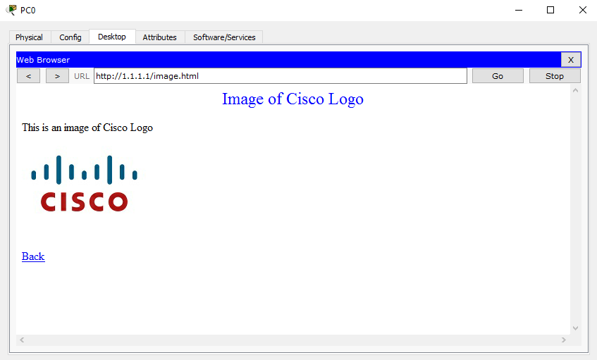
Validation and Verification Testing

Slide 12
Conclusion
Client now has an expanded network with added functionality
Mobile Devices have added much needed data accessibility
We learned how to expand upon a preexisting network

